Slide 1
Dr. Sunirmal Khatua
Fault Tolerance in Distributed Computing
By
Visvesvaraya Young Faculty Fellow, Govt. of India
Assistant Professor, University of Calcutta
Notes:
We celebrate Christmas to remember the birth of Jesus Christ

Slide 2
What is Fault Tolerance
The capacity of a Distributed System to tolerate the following types faults
Crash failure (Fail-Stop)
Omission failure (Send – Receive omission)
Timing failure (Synchronization)
Byzantine failure (Arbitrary faults)
X
C
S
C
X

Slide 3
Crash failure : Server Crash
Call Semantics based on Idempotency:
At least once : Try until a reply received.
At most once : Report failure without retry.
Exactly once : No way to guaranty.
C
S
At most once
At least once using Failure Transparency
try {
obref = lookup(“MyName”)
} catch(Exception e) {
Report Failure
}
success = false
while(!success) {
try {
obref = lookup(“MyName”)
success = true
} catch(Exception e) {
delay(2000)
}
}
Client Server
Reissue Strategy Strategy R -> E Strategy E -> R
REC RC(E) C(RE) ERC EC(R) C(ER)
ret = obref.method(“param”)
ret = obref.method(“param”)
Always
Never
Only when ACKed
Only when not ACKed
DUP | ONE | ONE
ONE | ZERO | ZERO
DUP | ONE | ZERO
ONE | ZERO | ONE
DUP | DUP | ONE
ONE | ONE | ZERO
DUP | ONE | ZERO
ONE | DUP | ONE

Slide 4
Crash failure : Client Crash
Client Crashes:
Orphan : Active Computation without parent.
Problems:
Waste CPU Cycle
Locked resources.
Confusion betw^{n} recovered client reissue & result from orphan
Solution:
Extermination :
Client stub maintains a log & kills the orphans explicitly at reboot.
Disadvantage:
Log maintenance is expensive.
Orphans may create grand-orphans by doing RPCs. Its very difficult to locate them
Even after locating they may not be killed due to partitioned network.
C
S

Slide 5
Crash failure : Client Crash
Reincarnation :
Divide times in epochs
Client broadcasts epoch when reboots
Upon hearing a new epoch servers kills the remote computation on behalf on that client
Gentle Reincarnation :
Upon hearing a new epoch servers kills the Orphan (RPC with non-void return type)
Expiration :
Each RPC is given a lease T to finish computation
If it does not, it needs to ask for another lease
If client reboots after T sec all orphans are gone
Problem: what is a good value of T?
C
S

Slide 6

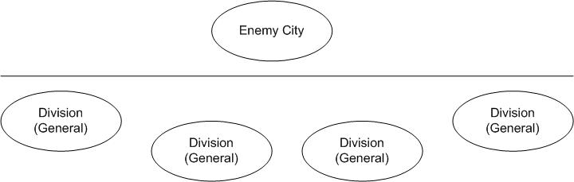

Byzantine Generals Problem (BGP)
Orders
Commander
The commander sends an order to n-1 lieutenant generals.
Condition IC1: All loyal lieutenant generals obey the same order.
Condition IC2: If the commander is loyal, every loyal general obeys the order that the commander issues.
General
General
General

Slide 7
Byzantine Generals Problem (BGP)
Orders
Commander
There are 2 Types of Generals : loyal and traitor
All loyal generals decide the same plan of action.
A small no. of traitors can’t cause loyal generals to adopt a bad plan.
The generals should reach a decision.
Byzantine Generals Problem : A commander must sends his order to n-1 generals such that
Condition IC1: All loyal generals obey the same order.
Condition IC2: If the commander is loyal, every loyal general obeys the order that the commander issues.
General
General
General

Slide 8
Impossibility for 3BGP
For n Generals and m Traitors
n > 3m
Commander
Attack
Retreat
Orders
General 1
?
General 2
Commander
Retreat
[Commander said]
Commander
Attack
Attack
General
General
General 1
?
General 2
Retreat
[Commander said]
General

Slide 9
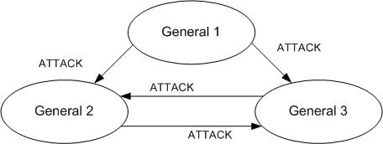
Solution : Oral Message OM(m)
Assumptions:
A1: Every message is delivered correctly. Message integrity is maintained.
A2: The receiver of a message knows who sent it.
A3: The absence of a message can be detected.
Majority(v₁,v₂, …, v_{n}) returns the majority value. If the majority does not exist, return RETREAT.
Step 1: OM(0)
The commander sends its value to each general
Each general accepts the value or accepts RETREAT if no message was sent.
Step 2: OM(m), m > 0, total n generals including the commander
The commander sends his value to every general
Let general i, receive value v_{i} from the commander.
It acts as a commander and sends v_{i} to the rest of the n-2 generals using OM(m-1)
The loyal generals in OM(m-1) come to an agreement about the value received by lieutenant i
For each i ≠ j, let v_{j} be the value general i receives from general j using OM(m-1)
It returns Majority(v₁,v₂, …, v_{n}) with the values it receives from OM(m-1)

Slide 10
Solution : Oral Message OM(m)
OM(m)
Commander
1. Don’t accept the value that the commander sends
General 1
General 2
General n
OM(m-1)
2. Ask the rest of the lieutenants and come to an agreement regarding the value sent by the commander

Slide 11
Example : Oral Message OM(m)
Commander
General 1 and General 2 compute majority (v,v,x) = v
v
v
v
General 1
General 2
General 3
v
x
Commander
Each general computes the same value: majority (x,y,z)
x
y
z
General 1
General 2
General 3
x
z
y
y
z
x

Slide 12
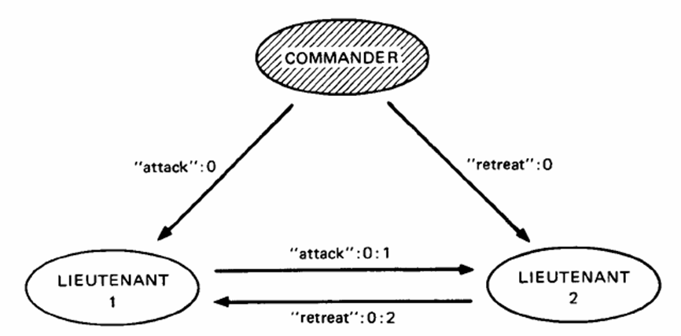
Solution : Signed Message SM(m)

